Slide 1
Tuesday 26th January

Slide 2
Phonics - Phase 3
Can you guess what our phoneme is today? See if you can write the words

Slide 3
Our phoneme today is…
snail
fail
ai
train
paint
Can you say these words with our phoneme in? See if you can sound out the words then blend to read

Slide 4
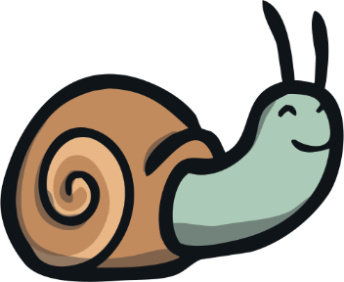
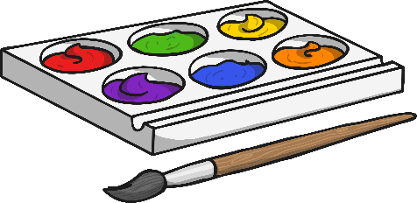
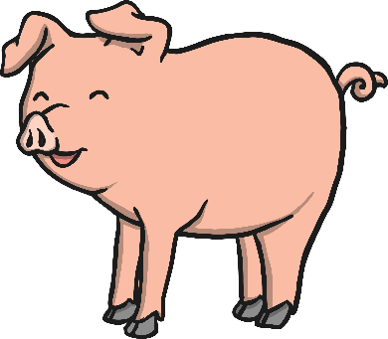
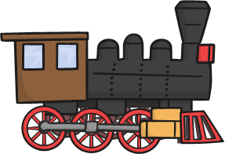
Click the pictures that contain the ‘ai’ sound to move them into the middle.
ai

Slide 5
Read the story on the next slide with a grown up to help you. See how many ‘ai’ words you can spot. You could highlight them or make a list on your whiteboard.

