Slide 1
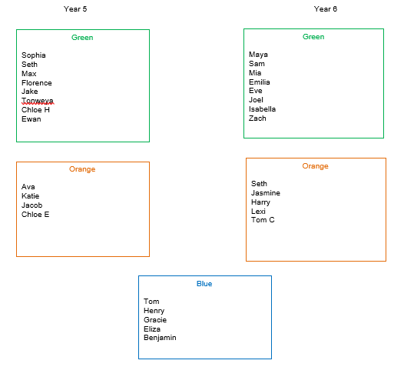
Spelling groups
29.01.21

Slide 2
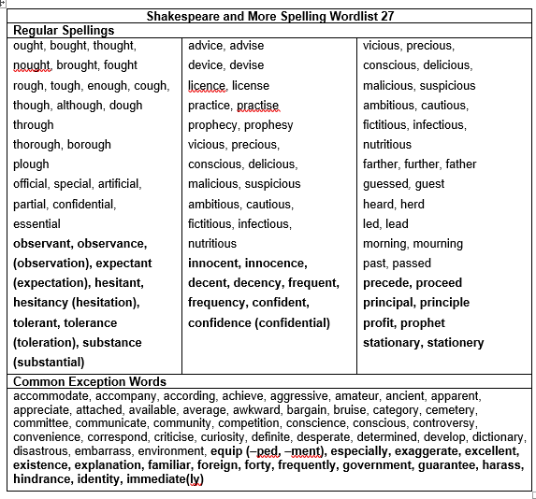
Year 5

Slide 3
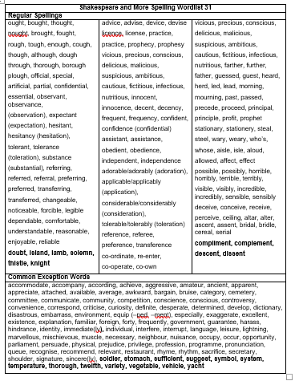
Year 6

Slide 4
29.01.21
Year 5- To spell common exception words correctly.
Year 6- To be common exception words correctly.

Slide 5
Year 5- To spell common exception words correctly.
What is a common exception word?

Slide 6
Spelling focus: To spell common exception words correctly.
Spelling words:
equipped
exaggerate
existence
familiar
guarantee
Your test will be on 05.02.21
on Teams

Slide 7
Year 6- To spell common exception words correctly.
What is a common exception word?

Slide 8
Spelling focus: To spell common exception words correctly.
Spelling words:
sufficient
temperature
yacht
twelfth
thorough
Your test will be on 05.02.21
on Teams

Slide 9
Blue group- To spell the second 200 high frequency words.
Spelling words:
again
I'll
boy
soon
want
cat
round
animals
Your test will be on 05.02.21 on Teams

Slide 10
Year 5 & 6
Blue:
You will be tested on the 8 spellings you're given.
Green:
You will be tested on the 5 spellings you're given plus 5 more. I will choose those 5 from the spelling sheet you have.
Orange:
You will be tested on the 5 spellings you're given plus 5 more. The 5 extra spellings may or may not be chosen from the spelling sheet you have.

Slide 11
Spelling task- 29.01.21
This week I would like you to write a short tale or story that includes the five words that I have given you to learn. You must use the words in the correct context, so you will need to know what they mean.
Please can you write this in your red spelling book. You need to underline the 5 spellings I gave you.

