Slide 1
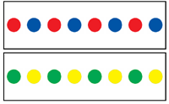
Patterns

Slide 2
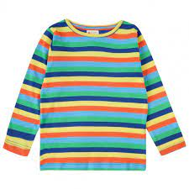
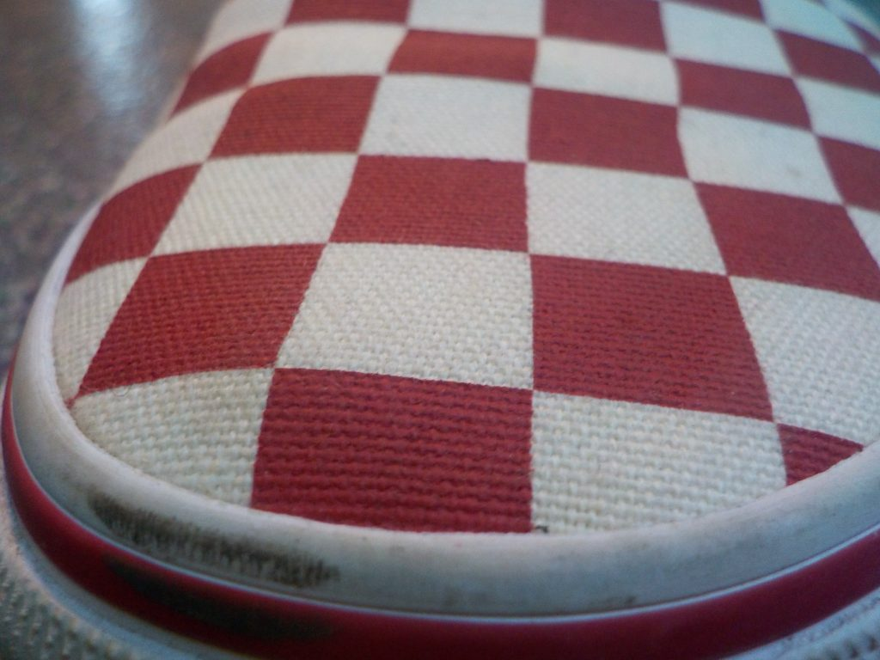
Can you go on a pattern hunt around your house?

Slide 3
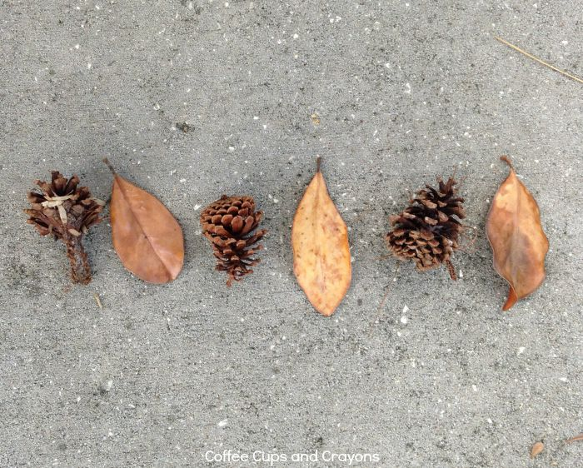
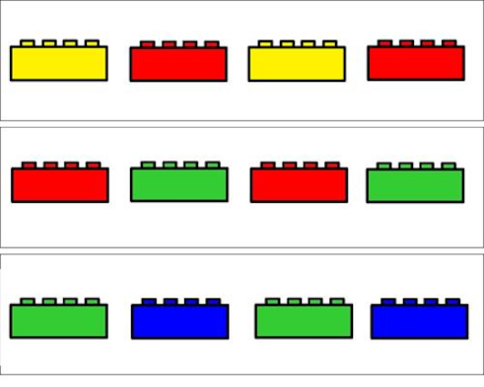
Can you recreate a pattern like these using different objects?

Slide 4
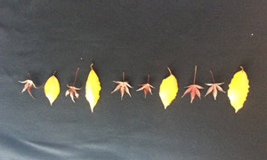
Can you recreate these patterns with objects at home?

Slide 5
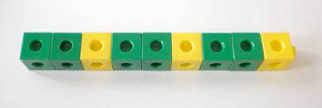
How about these patterns, can you recreate them?

Slide 6
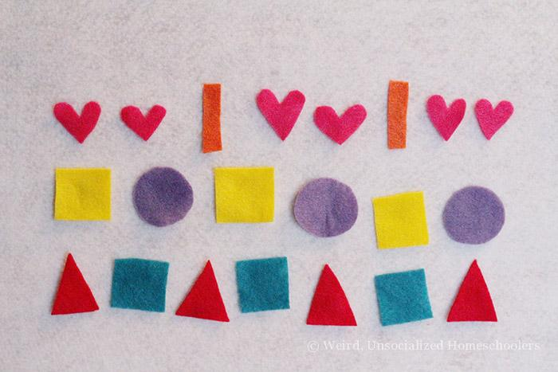
Can you make a pattern of your own?

Slide 7
We can also find patterns in sounds and actions. Can you recreate you pattern in this way?

