Slide 1
Tuesday 12th January

Slide 2
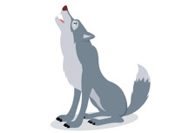
Phonics - Phase 3
Can you guess what our phoneme is today?

Slide 3
Our phoneme today is…
win
wash
w
window
web
Can you say these words with our phoneme in? See if you can sound out the words then blend to read

Slide 4
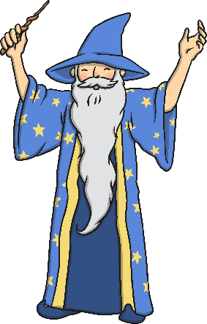
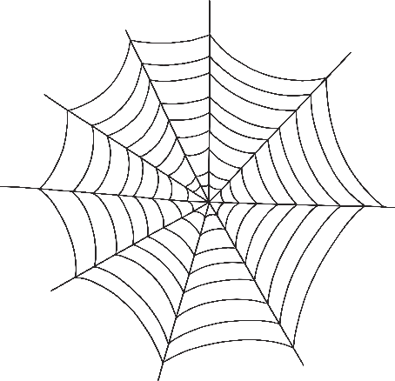
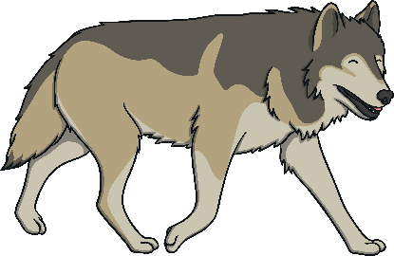
Click the pictures that begin with ‘w’ to move them into the middle.
w

Slide 5
Have a go at reading these questions. Is the answer YES or NO?
Is the sun wet? Can men jog to get fit?
Has a pot of jam got a lid?
Can a van go up a hill? Has a cat got a web?
Will a pig put on a wig?
Draw a picture to match one of these questions – e.g. a pig in a wig or a man jogging

