Slide 1
Collective Worship
Wednesday 13th January

Slide 2
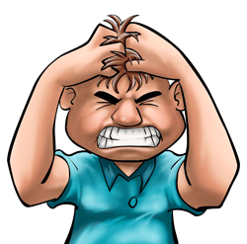
What is frustration ?

Slide 3
Why is it important to manage your frustration?

Slide 4
What is perseverance ?

Slide 5
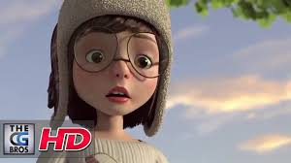

Slide 6
How did she do?
Did she persevere?
Did she succeed?
Did she manage her frustration?
What could she have done differently?

Slide 7
What will you do differently?
How will you help yourself to persevere?
How will you manage your frustration if you don’t get something right straight away?

Slide 8
Let us pray…
Dear God,
When we are struggling to become the people you want us be, help us to keep going When we struggle to control our tempers or our tongues, help us to keep going
And when we simply think we can't persevere any more, help us to keep going
Thank you that Jesus makes all things right in the end. Amen.

Slide 9
Go in faith, hope and love to believe, learn and flourish.

